Slide 1
Real World Software Testing

Slide 2
What is Quality ?
Quality from the:
Customer’s viewpoint Fit for use, or other customer needs.
Producer’s viewpoint meeting requirements.

Slide 3
What is Quality Assurance ?
Quality assurance activities are work process oriented.
They measure the process, identify deficiencies, & suggest improvements.
The direct results of these activities are changes to the process.
These changes can range from better compliance with the process to entirely new processes.
The output of quality control activities is often the input to quality assurance activities.

Slide 4
What is Quality Control ?
  Quality control activities are work product oriented
  They measure the product, identify deficiencies, & suggest improvements.
  The direct results of these activities are changes to the product.
  These can range from single-line code changes to completely reworking a product from design.
  They evaluate the product, identify weaknesses & suggests improvements.

Slide 5
The purpose of finding defects is to get them fixed.
The prime benefit of testing is that it results in improved quality. Bugs get fixed.
Secondary benefit includes:
    Demonstrate that software functions appear to be working according to specification.

Slide 6
Software quality management
Concerned with ensuring that the required level of quality is achieved in a software product.
Involves defining appropriate quality standards and procedures and ensuring that these are followed.
Should aim to develop a ‘quality culture’ where quality is seen as everyone’s responsibility.

Slide 7
Scope of quality management
Quality management is particularly important for large, complex systems. The quality documentation is a record of progress and supports continuity of development as the development team changes.
For smaller systems, quality management needs less documentation and should focus on establishing a quality culture.

Slide 8
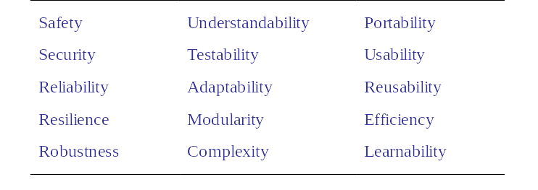
Software quality attributes

Slide 9
Quality management activities
Quality assurance
  Establish organisational procedures and standards for quality.
Quality planning
  Select applicable procedures and standards for a particular project and modify these as required.

Slide 10
Contd..
Quality control
  Ensure that procedures and standards are followed by the software development team.
Quality management should be separate from project management to ensure independence.

Slide 11
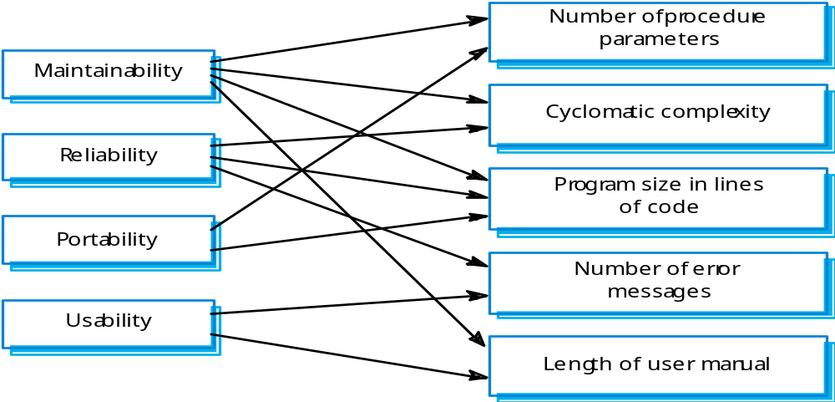
Internal and external attributes

Slide 12
Quality plans
Quality plan structure
  Product introduction;
  Product plans;
  Process descriptions;
  Quality goals;
  Risks and risk management.
Quality plans should be short, concise documents
  If they are too long, no-one will read them.

Slide 13
Quality planning
A quality plan sets out the desired product qualities and how these are assessed and defines the most significant quality attributes.
The quality plan should define the quality assessment process.
It should set out which organisational standards should be applied and, where necessary, define new standards to be used.

Slide 14
Test Software Quality Assurance
Test Software QA functions:
  Assess the effectiveness of the software development process through audits
  Report to management on the effectiveness of current processes
  Attend reviews of test software work products
  Ensure independent testing occurs
  Ensure action items are tracked to closure

Slide 15
  Incorporate improvements into test software procedures
  Ensure Software Problem Reports (PRs) are maintained, tracked, and closed
  Ensure Configuration Management processes are followed

Slide 16
Problem Reporting/Tracking
During development, all problems will be reported through the Problem reporting system
During testing, problems will be entered in the Problem Report (PR) system

Slide 17
  Problems or failures attributed to software will require opening a Software Change Request (CR). The CR number will be referenced in the PR. These problems will be tracked to closure as a CR. When work is complete the CR and PR will be closed

Slide 18
PR/CR Process
Problem/failure detected during Testing
PR entered
into system
PR
Analyzed
PR Impacts
Software
Track to closure
PR system
No
Yes
Generate
A CR
Close PR when
CR is closed
Track to closure
In CR system
Update PR
With CR #

